Slide 1
HOLY MARY INSTITUTE OF TECHNOLOGY AND SCIENCE
AI Powered Precision Agriculture Drone System
for Crop Health Monitoring and Management
Autonomous Monitoring & Intelligent Crop Analysis
1. A.PAVAN CHANDHAR - 22C91A6707
2. CH.PRAVEEN KUMAR - 23C95A6704
3. CH.SRAVAN KUMAR - 22C91A6738
4. B.SUNIL KUMAR - 22C91A6718
5. A. MANOJ KUMAR - 22C91A6710

Slide 2





DECODING THE SYSTEM
AI-Powered
Precision Ag
Drone System
Advanced machine learning algorithms to detect patterns, crop stress, and predict yield autonomously.
Targeted application of water, fertilizers, and pesticides to maximize efficiency and minimize waste.
UAVs equipped with multispectral sensors for high-resolution aerial mapping and real-time monitoring.

Slide 3

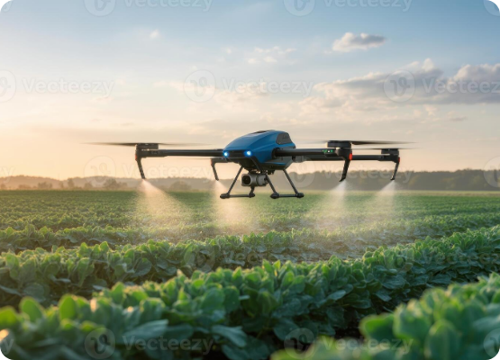
PROJECT ABSTRACT
This system delivers a complete AI-integrated pipeline for precision agriculture, utilizing RGB and Multispectral sensors.
Edge compute units for real-time analysis.
Detection of crop diseases and nutrient stress.
Optimization of irrigation and resource application.
Data-driven agronomic decision support.
The aim is to build a scalable solution to increase global food security through technological efficiency.

Slide 4

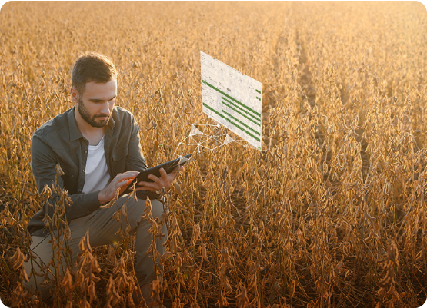
THE PROBLEM: CURRENT METHODS
Manual Crop Monitoring
Most farmers today rely on physical field scouting—walking through rows to find pests or diseases.
Time Intensive: Hard to cover large acreage efficiently.
Delayed Detection: Issues often caught too late to prevent loss.
Reactive, not Proactive: Relying on human eye and experience only.
Inefficient Spraying: Chemicals applied to whole fields rather than specific infected spots.

Slide 5



CURRENT PAIN POINTS
Environmental Vulnerability
High Operational Costs
Human Error
Labor for manual monitoring and wasted resources (water/fertilizer) increase overhead.
Inconsistent data collection and misidentification of plant pathologies.
Manual methods are highly disrupted by weather and environment factors.

Slide 6
THE PROPOSED INNOVATION
Our system integrates Autonomous Flight with Deep Learning to revolutionize monitoring.
Automated drone flight paths via GPS.
Real-time image processing using AI models.
Direct recommendations via a user-friendly Dashboard.
Early-stage detection of diseases invisible to the naked eye.

Slide 7



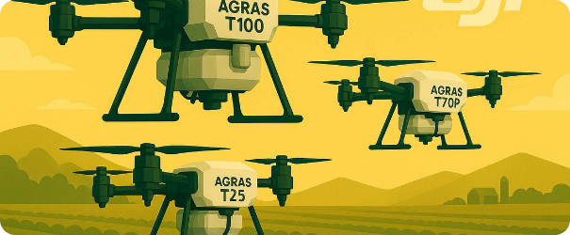

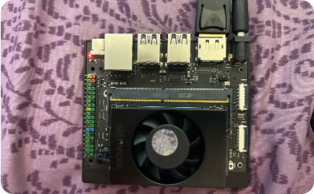
HARDWARE INFRASTRUCTURE
Core Flight System
Edge Computing
Quadcopter with 4K RGB Camera, NDVI Sensors, and precision GPS for mapping.
Jetson Nano / Raspberry Pi for onboard AI inference and sensor fusion.

Slide 8
SOFTWARE ECOSYSTEM
Category | Tools & Technologies
Languages | Python, JavaScript
AI Frameworks | TensorFlow, Keras, OpenCV
Cloud & Storage | Firebase, AWS S3
Mapping & GIS | QGIS, Flask (Web API)
Device Control | MAVLink, ArduPilot

Slide 9






AI ALGORITHMS APPLIED
CNN
YOLO
U-Net
Convolutional Neural Networks for classifying plant disease types from leaf images.
You Only Look Once (v8) for real-time detection of pests and localized anomalies.
Used for image segmentation to isolate diseased areas from healthy foliage.

Slide 10



EFFICIENCY & IMPACT METRICS
30%
15%
20%
Water Savings
Yield Increase
Fertilizer Reduction
Based on precision agriculture industry benchmarks for AI-drone integrated systems.

Slide 11
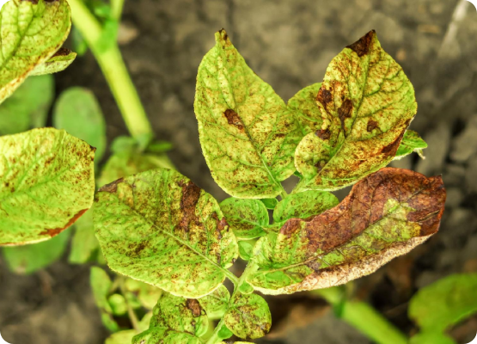
WHY THIS SYSTEM?
Early Detection: Spots issues before they affect yield.
Resource Efficiency: Precise chemical and water usage.
Labor Saving: Reduces need for physical manual labor.
Data Accuracy: Provides objective, sensor-based analytics.
Sustainability: Promotes eco-friendly farming practices.

Slide 12

Thank You!
Any Questions?
AI POWERED PRECISION AGRICULTURE DRONE SYSTEM
Holy Mary Institute of Technology and Science

